Slide 1

ECE 1710: Power Distribution Engineering and Smart Grids
Lecture 9
Dr. Robert Kerestes
University of Pittsburgh
Swanson School of Engineering
Department of Electrical and Computer Engineering
Notes:
Instructions for editing school and department titles:
Select from menu: View > Master > Slide Master
Click on each text area you wish to edit. Text will become editable.

Slide 2
Outline
Outline of Lecture No. 9
Module #1: Shunt Admittance of Overhead Lines
Module #2: Shunt Admittance of Concentric Neutral Underground Lines
Module #3: Shunt Admittance of Tape-Shielded Cable Underground Lines
Module #4: Sequence Admittance
Module #5: Shunt Admittance of Parallel Underground Lines

Slide 3
Learning Objectives
Learning Objectives:
Calculate phase impedance and shunt admittance matrices using Kron reduction
Write the matrix equation for voltage drop across a transmission line

Slide 4
Series impedance of overhead lines
Module #1

Slide 5
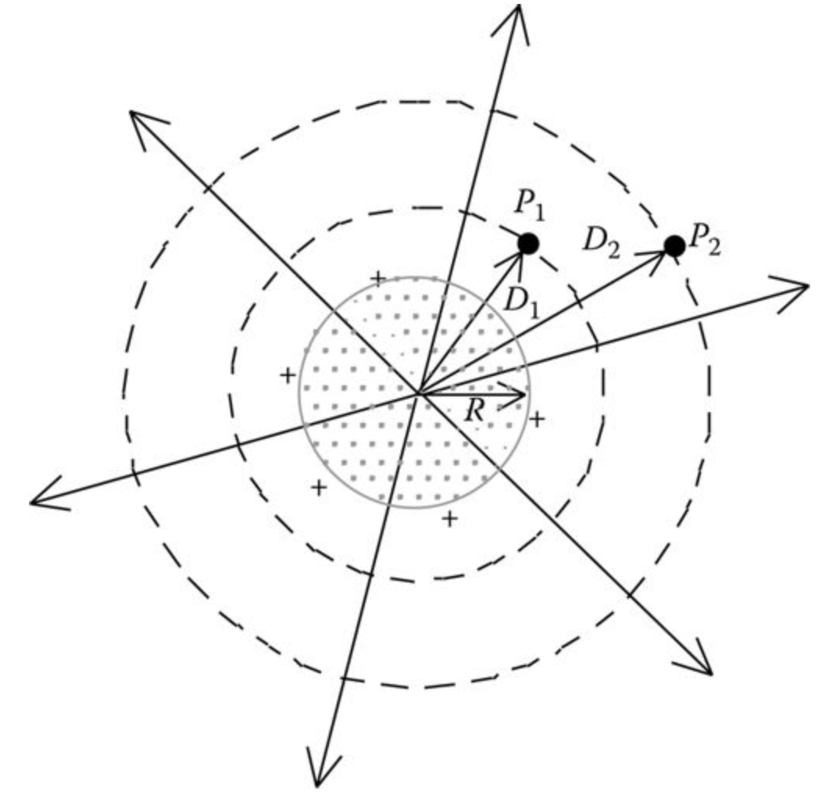
Shunt Impedance of Overhead Lines
Module #1
A charged conductor creates an electric field that emanates outward from the center of the conductor. Lines of equipotential are created that are concentric to the charged conductor.

Slide 6
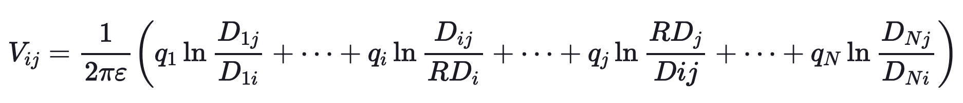
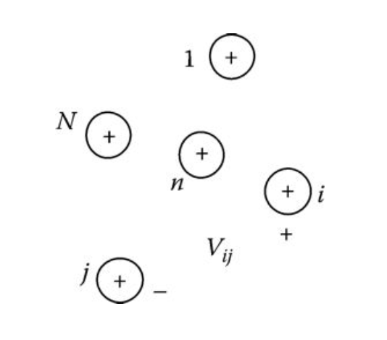
Shunt Impedance of Overhead Lines
Module #1
For an array of N positively charged conductors shown below, each having a unique charge density, q (C/m):

Slide 7
Shunt Impedance of Overhead Lines
Module #1
Where:
ε = ε₀ε_{r} is the permittivity of the medium
ε₀ is the permittivity of free space = 8.85 × 10⁻¹² F/m
ε_{r} is the relative permittivity of the medium
q_{n} is the charge density on conductor n (C/m)
D_{ni} is the distance between conductor n and conductor i (ft)
D_{nj} is the distance between conductor n and conductor j (ft)
D_{nn} is the radius (RD_{n}) of conductor n (ft)

Slide 8
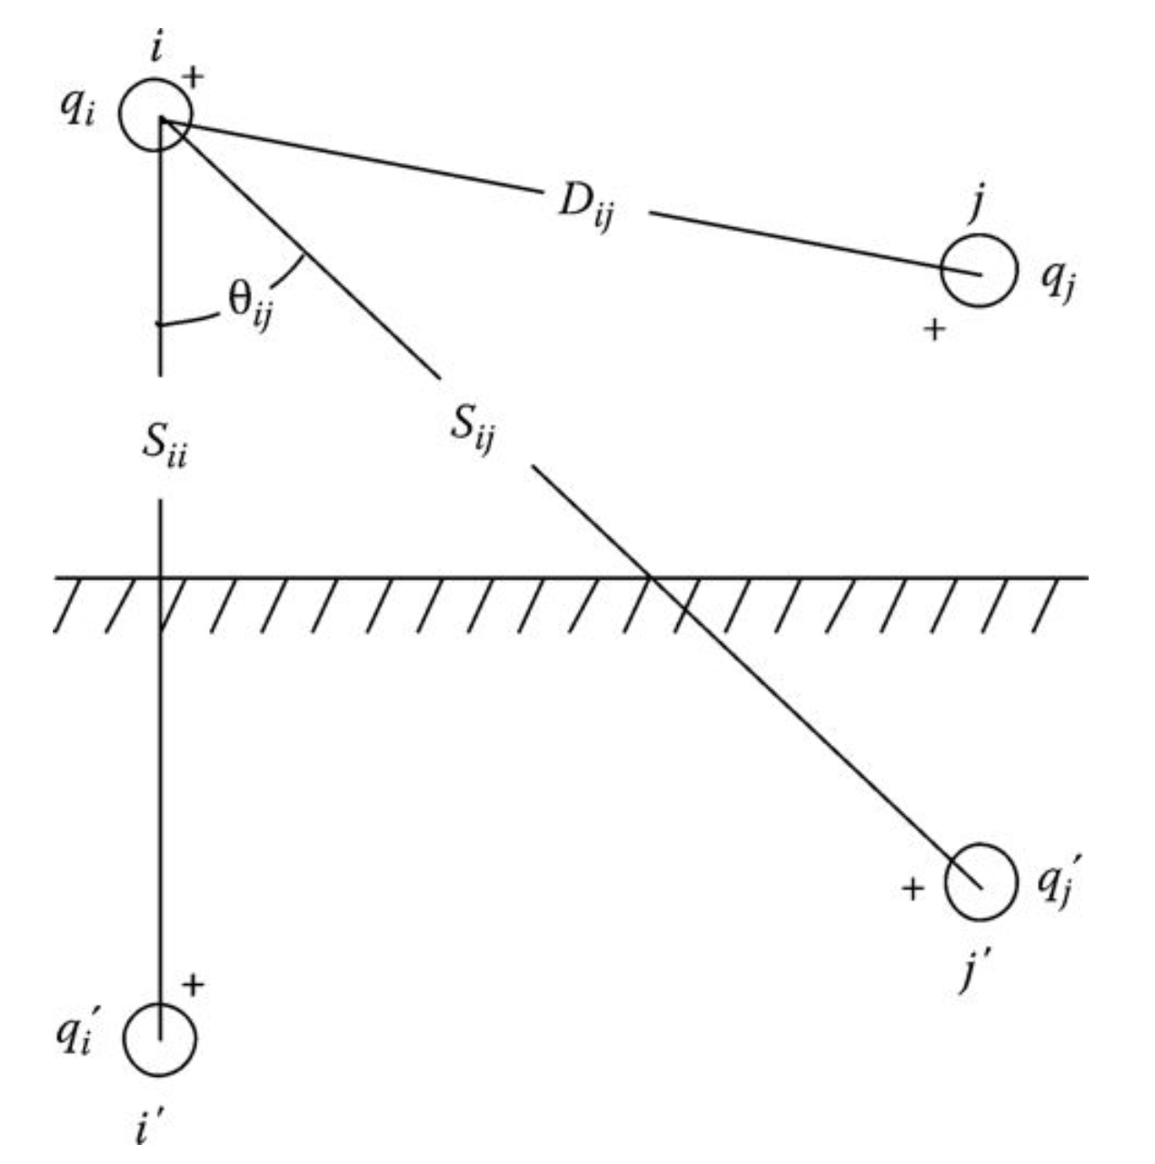
Shunt Impedance of Overhead Lines
Module #1
The method of conductors and their images is employed in the calculation of the shunt capacitance of overhead lines.

Slide 9
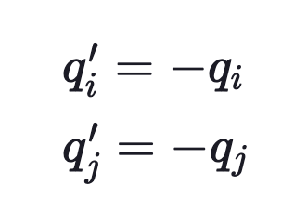
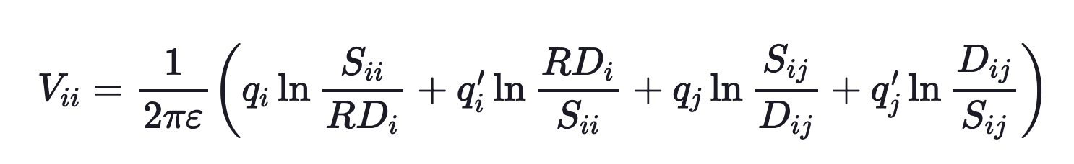
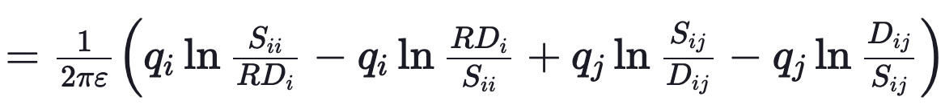
Shunt Impedance of Overhead Lines
Module #1
We can derive the simplified voltage equation Assuming that
We then have

Slide 10
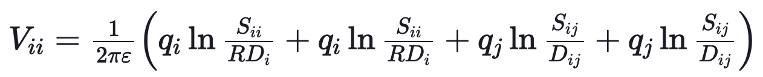
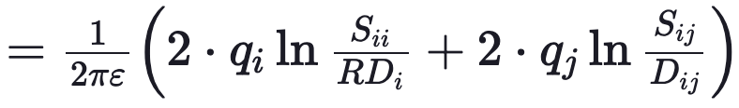
Shunt Impedance of Overhead Lines
Module #1
Simplifying we have
This gives the total voltage drop between conductor i and its image.

Slide 11
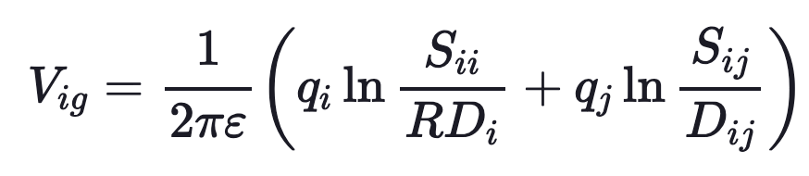
Shunt Impedance of Overhead Lines
Module #1
The voltage drop between conductor i and the ground will be one-half of the drop between conductor and image i.e.
Where:
S_{ii} is the distance from conductor i to its image i′ (ft)
S_{ij} is the distance from conductor i to the image of conductor j (ft)
D_{ij} is the distance from conductor i to conductor j (ft)
RD_{i} is the radius of conductor i in (ft)

Slide 12
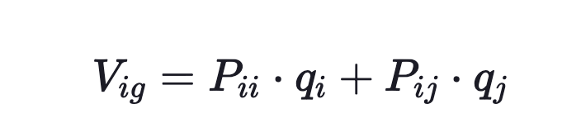
Shunt Impedance of Overhead Lines
Module #1
Now writing the self- and mutual-potential coefficients we have
Using air as the medium

Slide 13
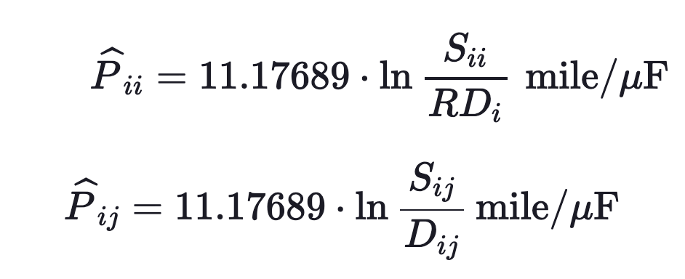
Shunt Impedance of Overhead Lines
Module #1
The self- and mutual- potential coefficients are defined as:

Slide 14
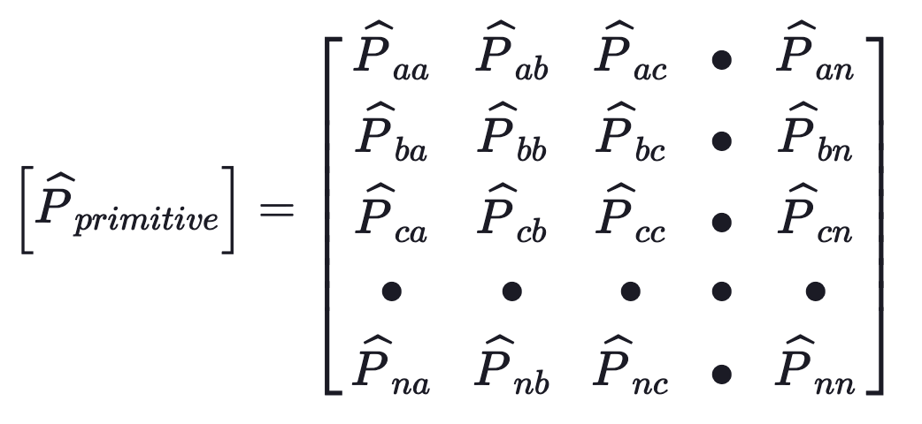
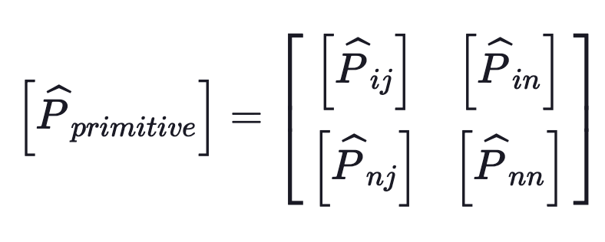
Shunt Impedance of Overhead Lines
Module #1
And finally the primitive potential coefficient matrix is
and in partitioned form

Slide 15
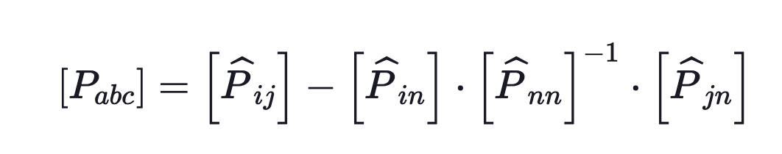
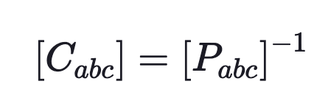

Shunt Impedance of Overhead Lines
Module #1
Using Kron reduction we then obtain the phase potential coefficient matrix
and then, inverting to obtain the phase capacitance matrix:
$$μF/mi$$

Slide 16

Shunt Impedance of Overhead Lines
Module #1
Note that the same rules apply for V phase, single phase and delta connections as did with series impedances.
Finally, we can assume that the conductance to ground is zero because the medium is air. Therefore given use the admittance matrix

Slide 17
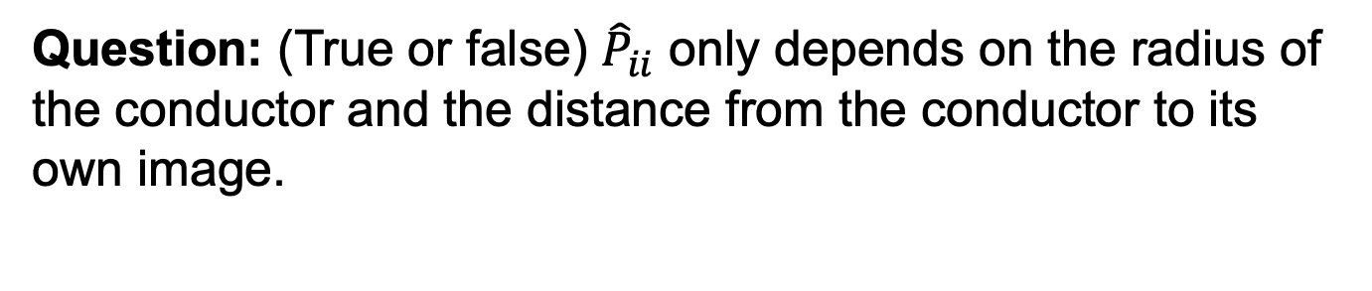
Shunt Impedance of Overhead Lines
Module #1
Question: (True or false) ${\hat{P}}_{ii}$ only depends on the radius of the conductor and the distance from the conductor to its own image.

Slide 18
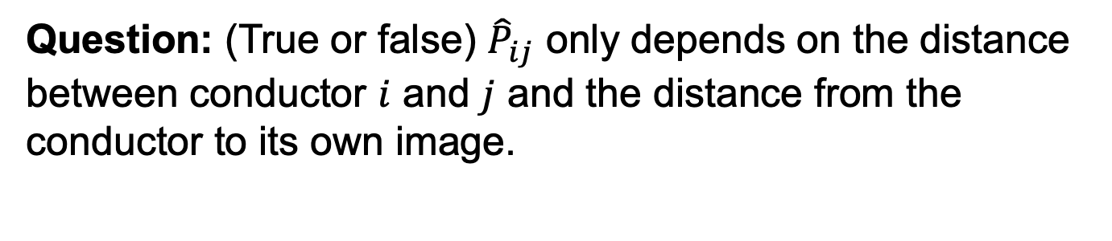
Shunt Impedance of Overhead Lines
Module #1
Question: (True or false) ${\hat{P}}_{ij}$ only depends on the distance between conductor $i$ and $j$ and the distance from the conductor to its own image.

Slide 19
Series Impedance of Overhead Lines
Module #2
Shunt Admittance of Concentric Neutral Underground Lines

Slide 20
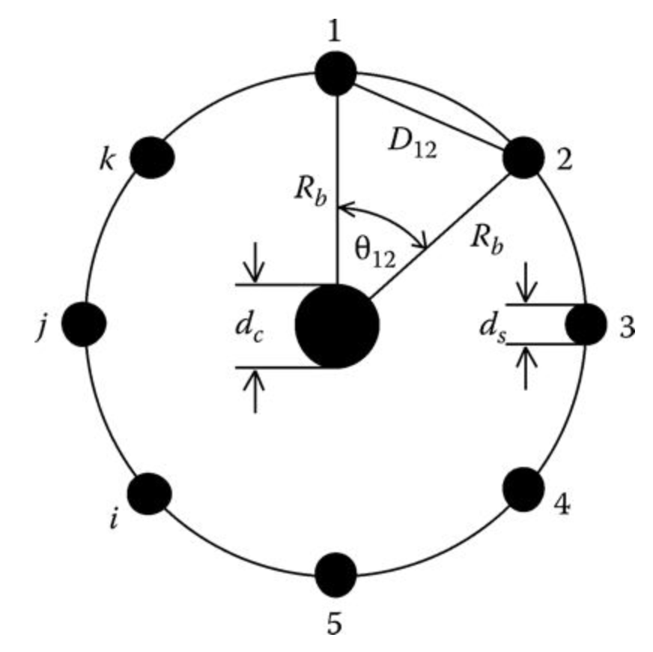
Shunt Admittance of Concentric Neutral Underground Lines
Module #2
Most underground distribution lines consist of one or more concentric neutral cables.
The following definitions apply:
R_{b} = Radius of a circle passing through the centers of the neutral strands
d_{c} = Diameter of the phase conductor
d_{s} = Diameter of a neutral strand
k = Total number of neutral strands

Slide 21
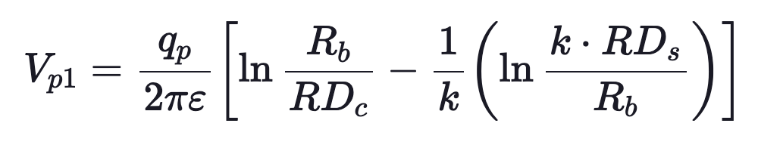
Module #2
Shunt Admittance of Concentric Neutral Underground Lines
The potential difference between a phase conductor and a neutral strand is given by:
See textbook for derivation

Slide 22
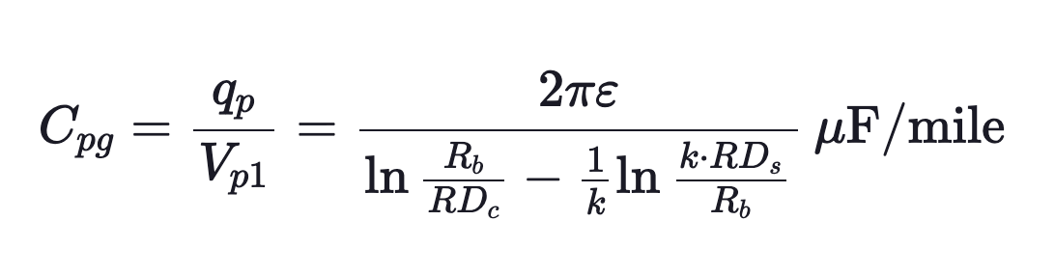
Module #2
Shunt Admittance of Concentric Neutral Underground Lines
Because the neutral strands are all grounded, the previous equation gives the voltage drop between the phase conductor and ground. Therefore, the capacitance from the phase to ground for a concentric neutral cable is given by:

Slide 23
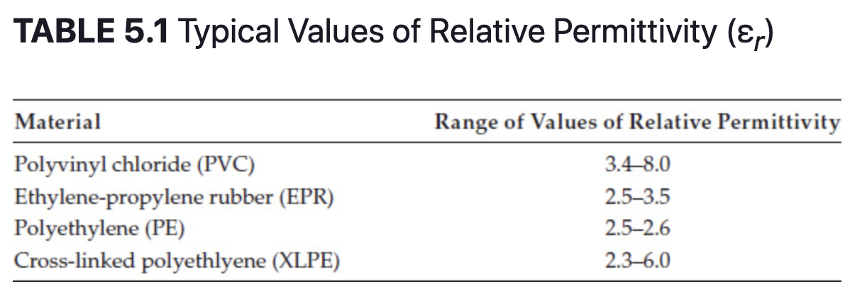
Shunt Admittance of Concentric Neutral Underground Lines
Module #2
For this equation, ε = ε₀ε_{r} = permittivity of the medium
ε₀ = permittivity of free space = 0.01420 μF/mile
ε_{r} = relative permittivity of the medium

Slide 24
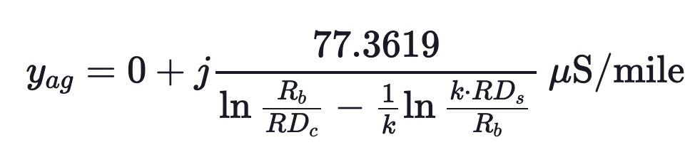
Shunt Admittance of Concentric Neutral Underground Lines
Module #2
Cross-linked polyethylene (XLPE) is a very popular insulation material. If the minimum value of relative permittivity is assumed (2.3), the equation for the shunt admittance (at 60 Hz) of the concentric neutral cable is given by:

Slide 25
Shunt Admittance of Concentric Neutral Underground Lines
Module #2
The mutual capacitance between lines can be considered to be zero, and the capacitance from concentric neutral to phase conductors can be considered zero. Thus the primitive or phase capacitance matrices are both diagonal.

Slide 26
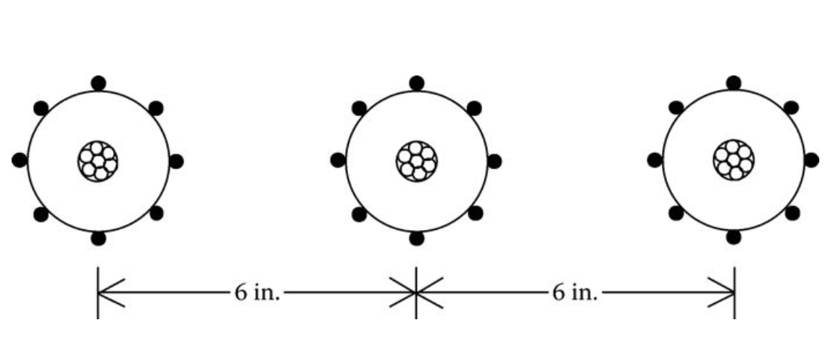
Shunt Admittance of Concentric Neutral Underground Lines
Module #2
Recall the example from lecture 8:
The cables are 15 kV, 250,000 CM stranded all aluminum with k = 13 strands of #14 annealed coated copper wires (1/3 neutral). The outside diameter of the cable over the neutral strands is 1.29 in. Determine the phase impedance matrix and the sequence impedance matrix. The insulation material is considered to be XLPE

Slide 27
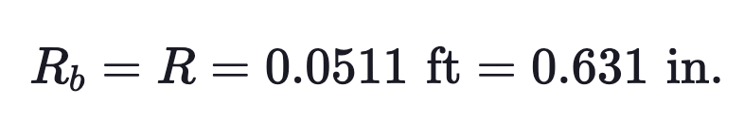
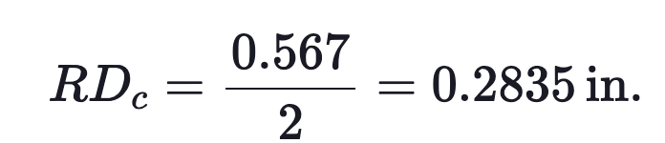
Shunt Admittance of Concentric Neutral Underground Lines
Module #2
Recall
Diameter of the 250,000 AA phase conductor = 0.567 in., so

Slide 28
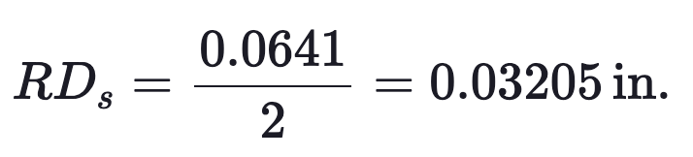
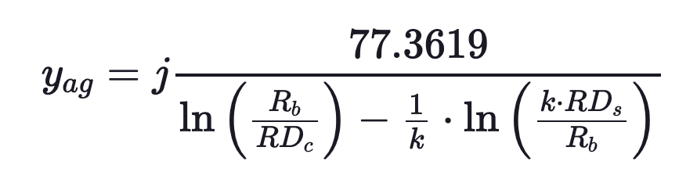
Shunt Admittance of Concentric Neutral Underground Lines
Module #2
Diameter of the #14 CU concentric neutral strand =0.0641 in., so
From phase a to ground we have:

Slide 29
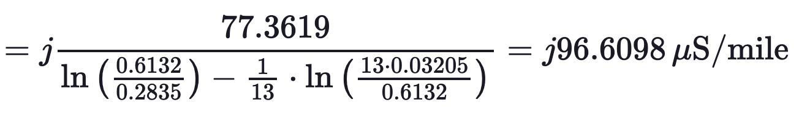
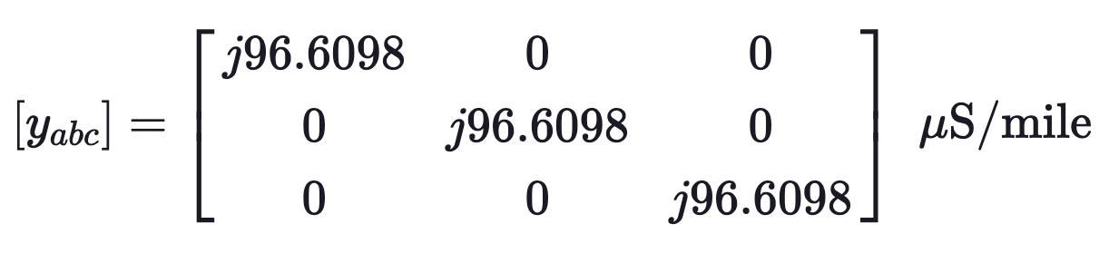
Shunt Admittance of Concentric Neutral Underground Lines
Module #2
Which gives us the shunt admittance matrix

